Slide 1
Summary of Test Case C1.5
Radial expansion wave (2D/3D)
1st International High-Order CFD Workshop
Jan, 7-8, 2012, Nashville, TN
Contributing groups:
Fidkowski, Galbraith, Gassner, Mavriplis, Van Leer, Z.J. Wang
1st International Workshop on High-Order CFD Methods

Slide 2
2D: Error vs. DOF
P =2
Expected order: 2P+1 on rectangles, P+1 on triangles.
Order short of 2P +1 on rectangles.
Cause: unexpected lack of solution smoothness at larger times.
All results for t=2, γ=3, for greatest smoothness.
Van Leer has lowest error.
P = 3
P =4
C1.5 Radial expansion wave

Slide 3
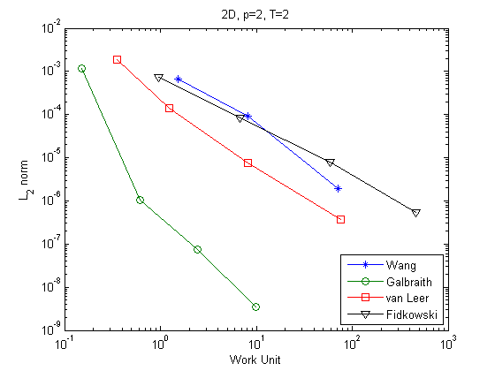
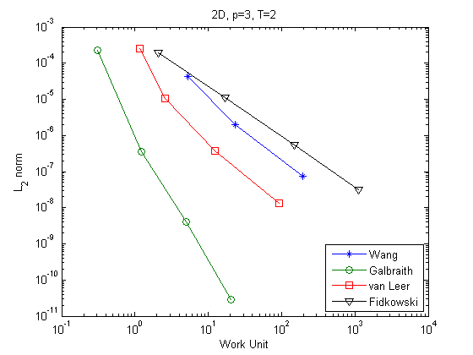
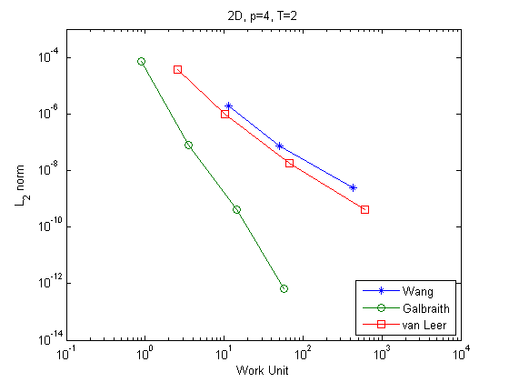
2D: Error vs. Work
P =2
P =2
Galbraith most efficient owing to use of analytical integration rather than Gaussian quadrature.
Van Leer second best.
P = 3
P = 3
P =4
P =4
C1.5 Radial expansion wave

Slide 4
3D: Error vs. DOF
P =2
Only regular hexahedral elements used.
Results even further below expected order due to lack of solution smoothness.
All results for t=2, γ=3.
Van Leer has lowest error.
P = 3
P =4
C1.5 Radial expansion wave

Slide 5
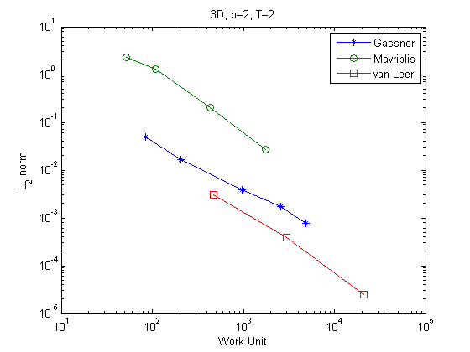
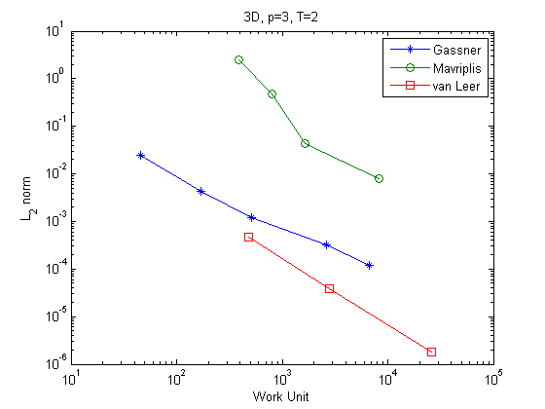
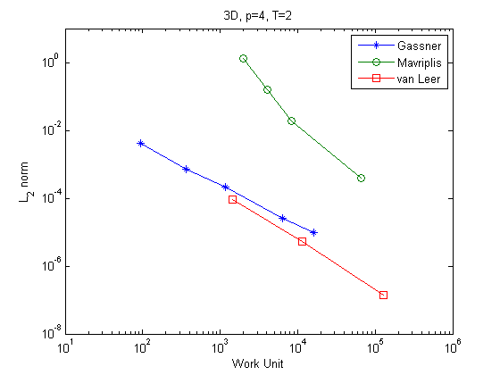
3D: Error vs. Work
Only regular hexahedral elements used
Van Leer most efficient.
P =2
P = 3
P =4
C1.5 Radial expansion wave

Slide 6
Conclusions
Before order of accuracy 2P+1 can be reached with any DG method, the problem of the non-smoothness of the solution must be fixed, possibly by adding a manufactured source term.
The consistently low errors of Van Leer et al. may be owing to high-order Gaussian quadrature used in anticipation of order of accuracy 2P+1.
C1.5 Radial expansion wave

