Slide 1
Case 1.6 Vortex transport by uniform flow
Case summary
First International High-Order
CFD Workshop
Jan. 7-8, 2012, Nashville, TN
Doru Caraeni, CD-Adapco.

Slide 2
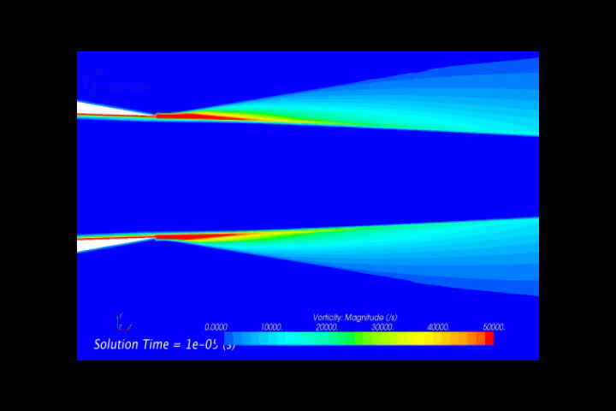
Case 1.6 Vortex transport by uniform flow
Canonical test case to:
Assess efficiency of HO methods for LES/DES of turbulent flows,
Compare relative efficiency of different unsteady HO methods,
Compare HO algorithm's efficiency with state-of-art 2nd order FV algorithm.

Slide 3

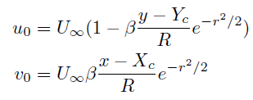


Case 1.6 Vortex transport by uniform flow
Case definition:

Slide 4
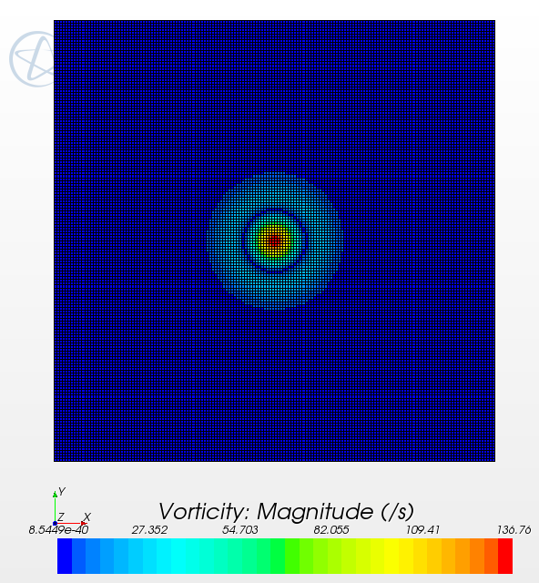
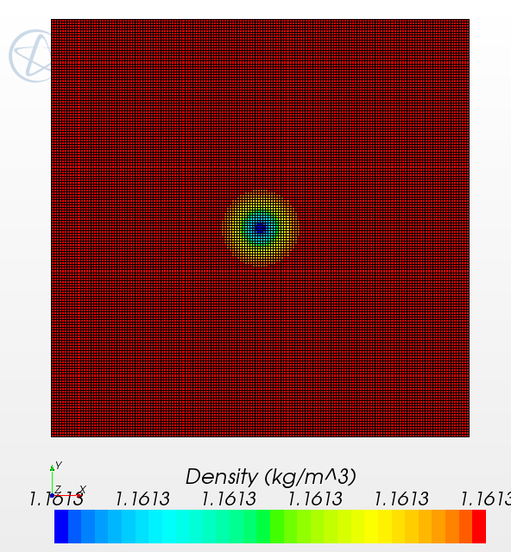
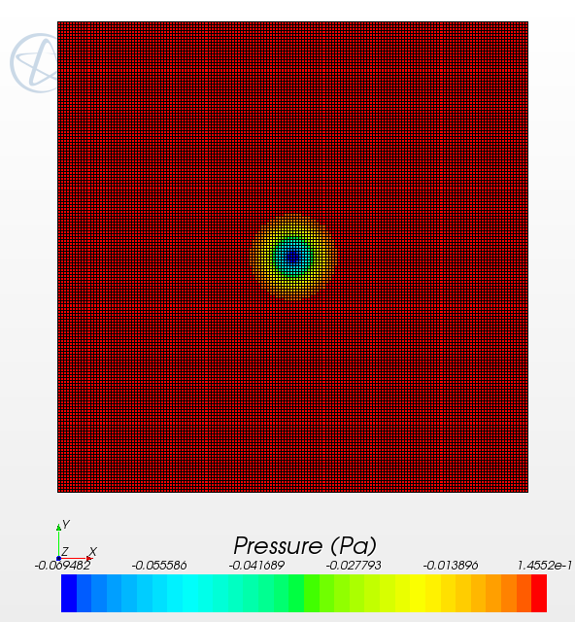
Case 1.6 Vortex transport by uniform flow
Very low Mach number flow (Mach = 0.05)
Large disparity between the sound and flow speed
Difficulties expected for explicit solvers due to time-step restriction

Slide 5
Case 1.6 Vortex transport by uniform flow
High-order algorithms proposed
Wang & Li : CPR-DG, p =1..5, RK 4th order
Bassi & Nigro : DG, p = 2 ..6, TVD-RK 3rd order, SSP-RK 4th order
Fidkowski : DG, p = 0 .. 3, RK
Tu : DG-CVS, p = 3, space-time formulation

Slide 6
Case 1.6 Vortex transport by uniform flow
State-of-art 2nd order FVM solver:
Roe FDS flux discretization,
Low Mach number preconditioning,
Implicit 2nd order time discretization (dual time stepping),
Solution reconstruction using LSQ
Reconstruction gradients limiting using a low dissipation
differentiable limiter
- Time-step was selected “sufficiently small” to not affect accuracy
(for a convective Courant ~0.25)

Slide 7
Case 1.6 Vortex transport by uniform flow
Work units

Slide 8
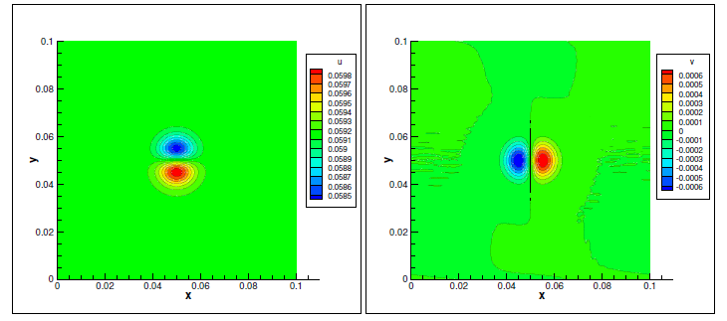
Case 1.6 Vortex transport by uniform flow
5th order DG uniform mesh results

Slide 9
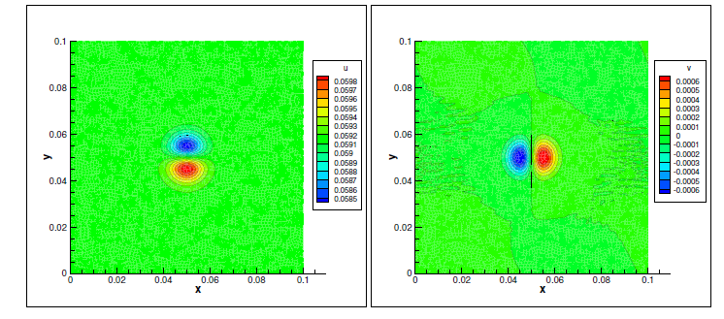
Case 1.6 Vortex transport by uniform flow
5th order DG Perturbed mesh results (some wiggleness)

Slide 10
Case 1.6 Vortex transport by uniform flow
Summary of results:
Three versions of DG algorithms were compared
The big absents are :
- High order (reconstruction based) FVM ?
- High-order Multidimensional-Upwind schemes,
- Spectral elements, High-order spectral finite differences, etc.
All HO results show a big advantage of using HO time/space
discretization.
Results show that HO methods can bring a leap in efficiency
of solving unsteady flows (LES/DES,URANS)

Slide 11
Case 1.6 Vortex transport by uniform flow
Challenges of LES/DES of turbulent flows:
Large variety of turbulent/vortical scales,
Vorticity preservation and kinetic energy preservation
(in incompressible flows) is essential for success,
Grid size changes, cell stretching and skewness can be important,
Explicit schemes are probably not be able to cope with extreme
time-step limitations due to viscous stability conditions,
How the new HO algorithms are going to be fitted into current
commercial CFD codes architecture ?

