Slide 1
Case 3.3 Summary
Transitional Flow Over the SD7003 Airfoil
1st International Workshop on High-Order CFD Methods
7-8 Jan 2012, Nashville, TN
Miguel Visbal
  Computational Aero-Physics Branch
  Air Force Research Laboratory
  WPAFB, OH

Slide 2
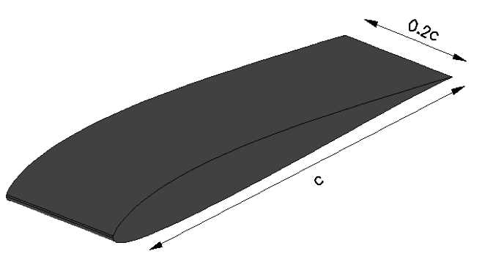
Case 3.3 Description
Transitional flow over a SD7003 airfoil wing section
Aimed at characterizing the accuracy and performance of high-order solvers for the prediction of complex unsteady transitional flows
Geometry details:
Selig SD7003 airfoil
8.5% max thickness
1.45% max camber at x/c = 0.35
Trailing edge rounded with small circular arc with r/c = 0.0004.
Homogeneous spanwise direction with periodic boundaries, s/c=0.2.
Re_{c} =60,000
Mach no. = 0.1
α = 4, 8 deg

Slide 3
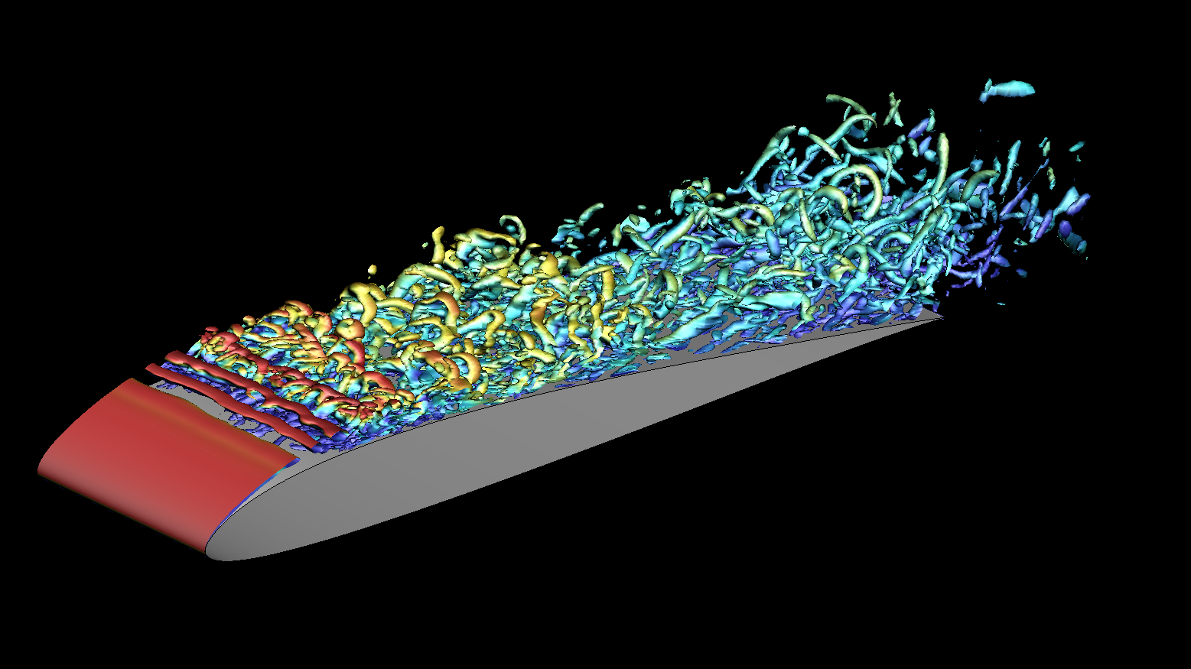
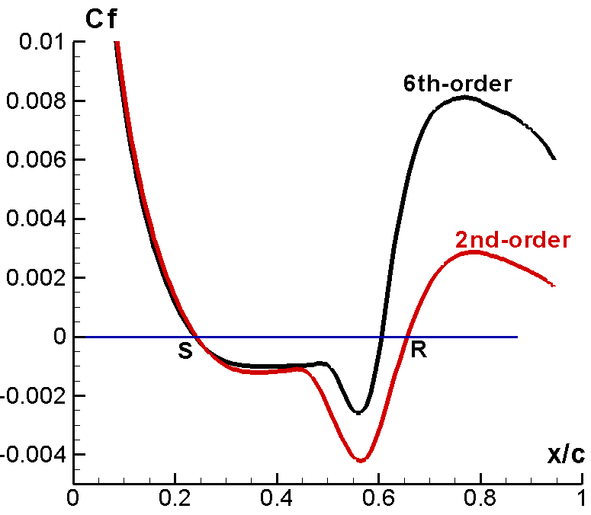
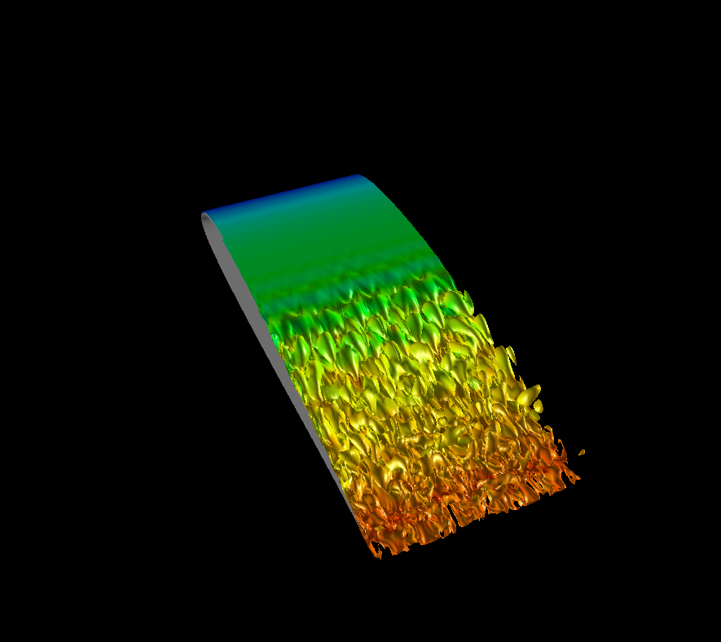
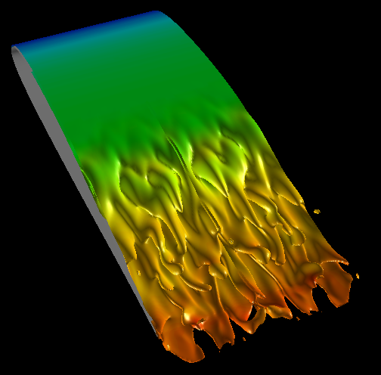
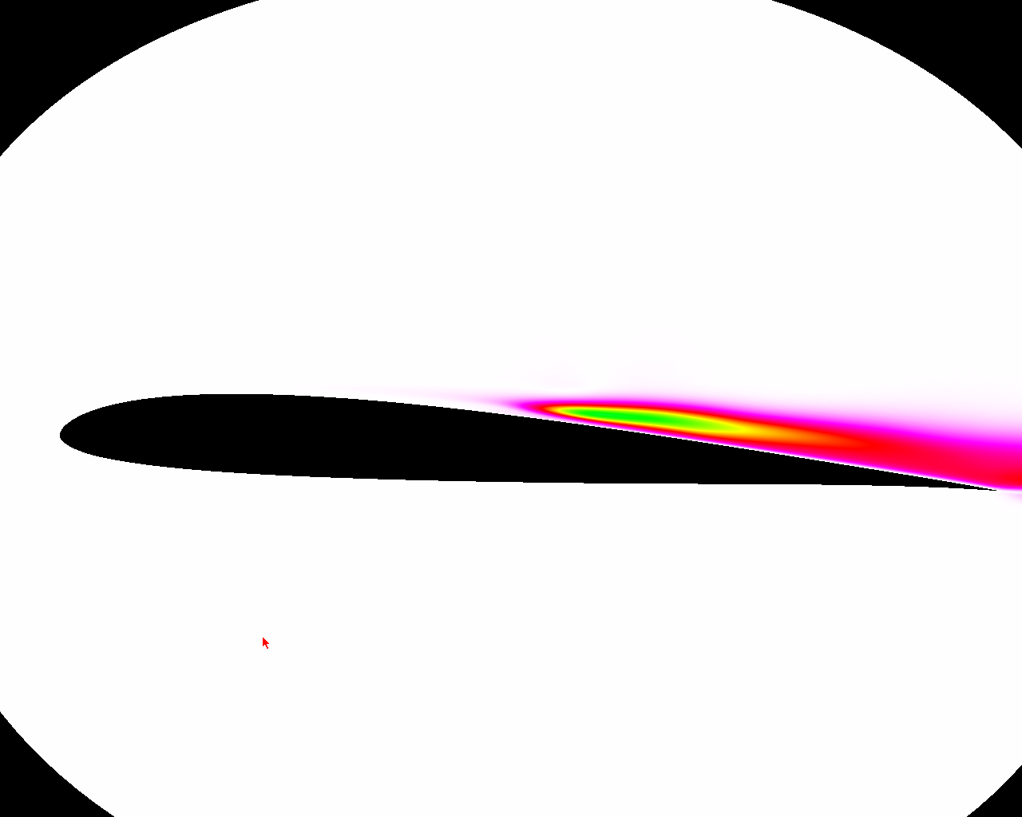
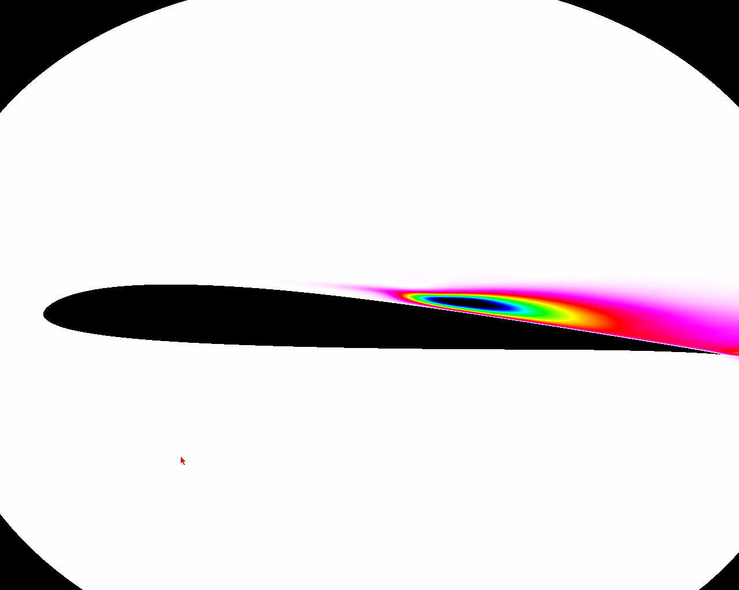
Case 3.3 Challenges
experiments shown to be
highly sensitive to FST
laminar
shear layer
spanwise instabilities
K-H instabilities
time-averaged
flow
LSB
6th-Order
2nd-Order
2ND-order
6TH-order
Reynolds Stress (u’ v’ )

Slide 4
Case 3.3 Contributors
Group | case (deg) | spatial scheme | time marching | Max (Δs/c) | L.E. (Δs/c) | Δt U/c | ds+, dn+, dz+ @ x/c=0.8 | Far field Boundary (chords)
AFRL | 4 & 8 deg | C6-F10 6th-order | 2nd-order implicit w/ sub-iterations | 0.0051 | 0.001 | 0.0001 | 14.4, 0.1, 9.1 | 100
CENAERO | 4 deg. | 4th-order DG/SIP | 3BDF | 0.012 | 0.0007 | 0.0002 | 17.2, 2.8, 28.6 | < 15
ISU | 8 deg. | SD 3rd-order | RK3 | 0.01 | 0.002 | 0.0002 | --- | 100

Slide 5
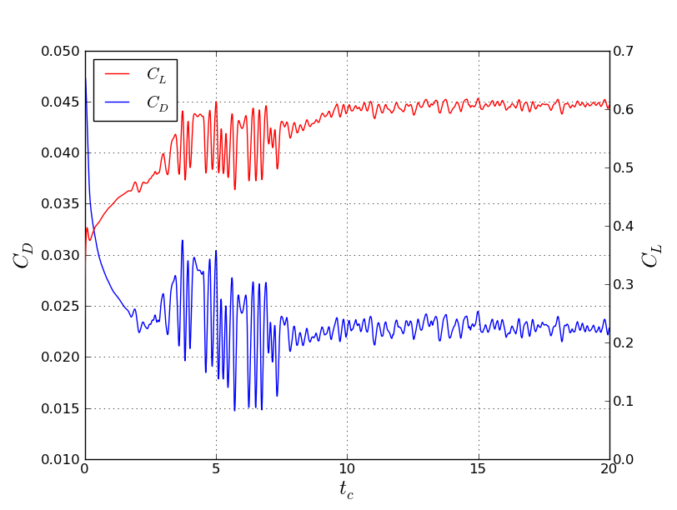
AFRL & CENAERO Comparison load histories, α = 4°
6th-order compact
4th-order DG

Slide 6

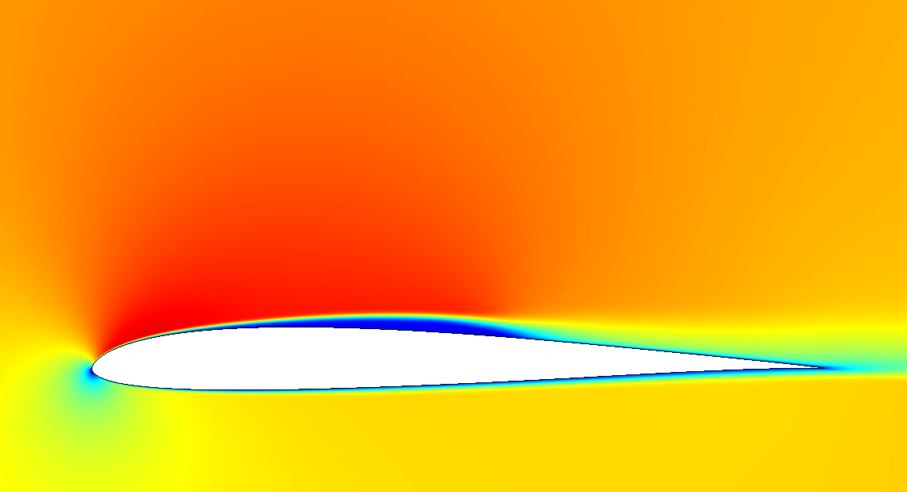

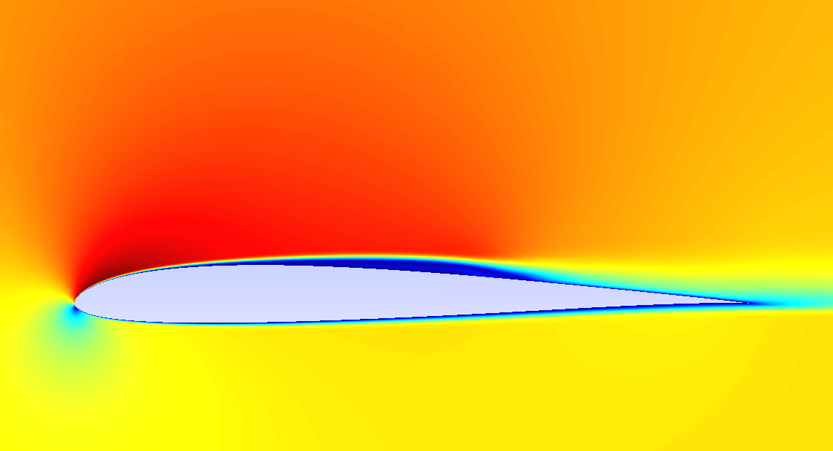
AFRL & CENAERO Comparison mean flow, α = 4°
pressure
u-velocity
6th-order compact
4th-order DG

Slide 7
AFRL & CENAERO Comparison
Skin friction and pressure coefficient, α = 4°
AFRL, 6th –order compact
CENAERO, 4th-order DG
Group | (x/c)_{sep} | (x/c)_{reatt} | L_{sep}
AFRL | 0.16 | 0.59 | 0.43
CENAERO | 0.21 | 0.66 | 0.45

Slide 8
AFRL & CENAERO Comparison
Velocity and mean-squared fluctuations, α = 4°
AFRL, 6th –order compact
CENAERO, 4th-order DG
<u>
<u’²>

Slide 9
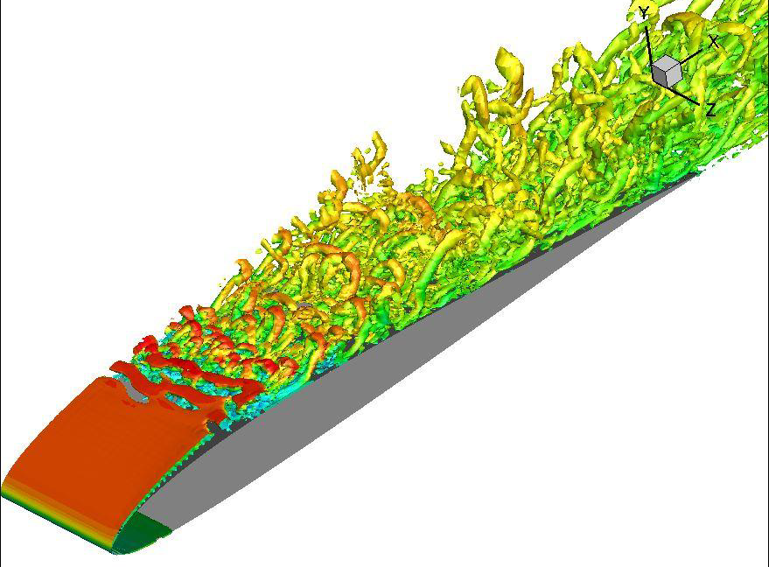
AFRL & ISU Comparison
Q-criterion, α = 8°
ISU, 3rd-order SD
AFRL, 6th –order compact

Slide 10
AFRL & ISU Comparison α = 8°
AFRL, 6th –order compact
ISU, 3rd-order SD
Group | (x/c)_{sep} | (x/c)_{reatt} | L_{sep}
AFRL | 0.023 | 0.26 | 0.24
ISU | 0.18 | 0.29 | 0.11
<u>

Slide 11
computational resources
Group | computer | # cpu’s | secs per time step | time for T=10tc hours
AFRL | 2.4-GHz AMD Opteron | 208 | 1.33 | 37
CENAERO | Intel Xeon 2.5GHz | 400 | 150 | 457
ISU | NVIDIA Tesla GPU | - | 0.3 | 41

Slide 12
Effect of grid resolution
Skin friction and pressure coefficient
AFRL, 6th-order, α = 8°

Slide 13
Effect of filter coefficient
Skin friction and pressure coefficient
AFRL, 6th-order, α = 8°

Slide 14
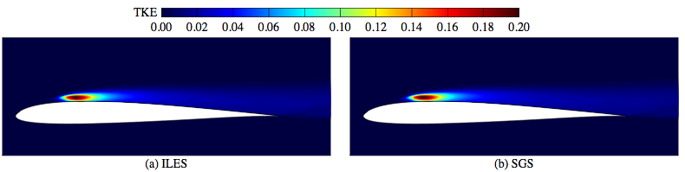
ILES vs. SGS-based LES
Skin friction and pressure coefficient
AFRL, 6th-order, α = 8°

Slide 15
Summary
I would like to acknowledge contributors. This is a non-trivial case requiring substantial computational resources
So far results are only qualitatively consistent across schemes
Quantitative discrepancies in separation, reattachment and transition locations, as well as in aerodynamic loads need to be accounted for
Future recommendations
  additional contributions desirable
  Common structured grid
  Limit to one angle of attack
  Fix outer boundary location, time to gather statistics, etc….
  Grid resolution studies required (computationally intensive)

